Slide 1
Power analysis for the PDT pilot
Hongchao Qi
September 2025

Slide 2
Strategy summary
Primary outcome: % under-threshold donations
Two arms:
Universal on-session testing: using copper sulphate followed by venous HemoCue (instead of capillary HQ)
PDT: PDT with on-session tests for targeted subset
Arm | Hb at current visit* | Inter-donation interval (weeks) | On-session test**
On-session | Very low (defer) | 52 | √
 | Low (defer) | 12 | √
 | Medium/High | 12 (m) / 16 (f) | √
PDT | Very low | 52 | √
 | Low (defer) | 12 | √
 | Low | 26 | √
 | Medium | 12 (m) /16 (f) | √
 | High | 12 (m)/16 (f) | ×
* on-session = Hb detected on-session / PDT = Hb detected post-donation
** for PDT, indicates action at next visit
Medium = 125-134g/l (female), 135-144g/l (male)

Slide 3
Stepped wedge roll-out structure
Stepped wedge design:
3 clusters (donation centres)
4 phases (4 months per phase) – the pilot will last for 16 months, covering all the seasons in a year
 | Baseline | Phase 1 | Phase 2 | Phase 3
Cluster 1 | On-session | PDT | PDT | PDT
Cluster 2 | On-session | On-session | PDT | PDT
Cluster 3 | On-session | On-session | On-session | PDT

Slide 4
Defining non-inferiority
We derived expected % of under-threshold donations (onsite test: CS+venous HQ) based on our simulation models (Qi et al., Transfusion, 2025)
 | Strategy | Over-threshold donations (%) | Under-threshold donations (%) | Low Hb deferrals (%)
Men | On-session | 92.6 | 5.4 | 2.0
 | PDT | 93.8 | 4.9 | 1.2
Women | On-session | 87.3 | 7.9 | 4.8
 | PDT | 89.0 | 7.8 | 3.3
Based on the simulation results, PDT is better than on-session only both in under-threshold donations and low Hb deferrals. But we are still interested in a non-inferiority trial, so non-inferiority margins are needed.
Men: Expected decrease under PDT = 0.5%.
Women: Expected decrease under PDT = 0.1%
We will try several candidate non-inferiority margins in the power analysis.

Slide 5
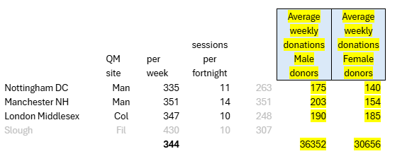
Candidate blood centres
Based on the information about the candidate blood centres:
Average number of samples per centre per 4 months is ~3250 for men
Average number of samples per centre per 4 months is ~2740 for women

Slide 6
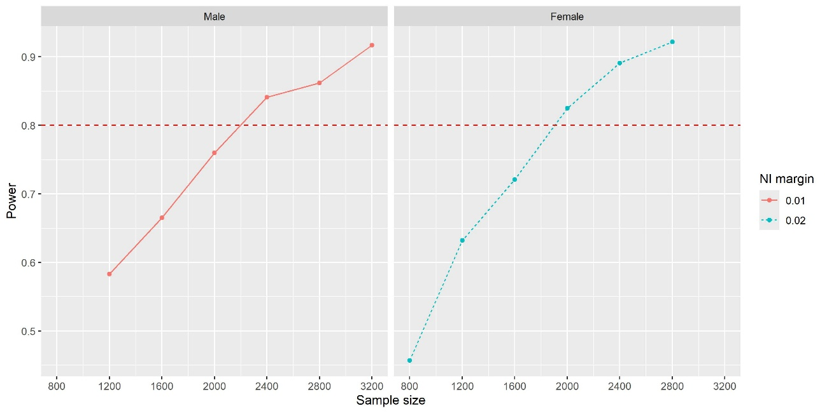
Results of the power analysis
Men: with 1% non-inferiority margin (accept 6.4% under-threshold donations) and 3250 donations per centre per phase, power is 90.4%.
Women: several candidate values tested, corresponding power values shown below.
We can achieve a statistical power>80% based on the non-inferiority margins (men: 1%; women: 2%) and sample sizes, the total number of samples will be 3250*12 (blocks) + 2740*12 (blocks)= 71,880. Power curves are presented below.
Non-inferiority margin | Power
1% | 42%
1.5% | 73.2%
2% | 92.2%

Slide 7
Summary
The design will be a stepped wedge design with 3 donation centres and 4 phases (4 months per phase), lasting for 16 months.
Assume we can collect ~190 samples per centre per week for men (i.e., 3250 per 4 months) and ~160 samples per centre per week for women (i.e., 2740 per 4 months), we can achieve 80% statistical power based on the non-inferiority margins (1% for men, 2% for women).
Total number of samples will be 71,880 for the pilot study, which we think is feasible.

